Slide 1
What is ICH?
ICH is a joint initiative involving both regulators and research-based industry representatives of the EU, Japan and the US in scientific and technical discussions of the testing procedures required to assess and ensure the safety, quality and efficacy of medicines.

Slide 2
What does ICH stand for?
The complete name of ICH is the “International Conference on Harmonization of Technical Requirements for Registration of Pharmaceuticals for Human Use”.

Slide 3
Aim :
The International Conference on Harmonisation of Technical Requirements for the Registration of Pharmaceuticals for Human Use (ICH) was established in 1990 as a joint regulatory/industry project to improve, through harmonisation, the efficiency of the process for developing and registering new medicinal products in Europe, Japan and the United States, in order to make these products available to patients with a minimum of delay.
The six parties to ICH represent the regulatory bodies and research-based industry in the three regions, Europe, Japan and the USA, where the vast majority of new medicines are currently developed.

Slide 4
ICH :
The International Conference on Harmonisation of Technical Requirements for Registration of Pharmaceuticals for Human Use (ICH) is a unique project that brings together the regulatory authorities of Europe, Japan and the United States and experts from the pharmaceutical industry in the three regions to discuss scientific and technical aspects of product registration.
Purpose :
The objective of ICH is to increase international harmonization of technical
requirements to ensure that safe, effective, and high quality medicines are developed and registered in the most efficient and costeffective
manner

Slide 5
Objective :
The objective of such harmonisation is a more economical use of human, animal and material resources, and the elimination of unnecessary delay in the global development and availability of new medicines whilst maintaining safeguards on quality, safety and efficacy, and regulatory obligations to protect public health.
Harmonising the technical content of the sections of the reporting data where significant differences have been identified between regulatory requirements across the three regions: Europe, Japan and the USA.

Slide 6
Target :
Target for the first phase of ICH activities was to remove redundancy and duplication in the development and review process, such that a single set of data could be generated to demonstrate the quality, safety and efficacy of a new medicinal product.
Harmonised format has led to the creation of the ICH Guideline M4, The Common Technical Document (CTD).
The Electronic Common Technical Document (eCTD) was developed subsequently by the M2 Expert Working Group.

Slide 7
Steering Committee structure and participation :
The existing Steering Committee structure continues to be appropriate. In the interests of greater transparency, the Steering Committee, however, welcomes the appropriate participation of other interested parties in a flexible and ad hoc manner on topics which affect them.
Global co-operation
The recent emphasis on global co-operation actions by ICH acknowledges the important role of WHO in disseminating information and providing input beyond the ICH regions.

Slide 8
Structure of ICH
ICH is a joint initiative involving both regulators and industry as equal partners in the scientific and technical discussions of the testing procedures which are required to ensure and assess the safety, quality and efficacy of medicines.
The focus of ICH has been on the technical requirements for medicinal products containing new drugs. The vast majority of those new drugs and medicines are developed in Western Europe, Japan and the United States of America and therefore, when ICH was established, it was agreed that its scope would be confined to registration in those three regions.

Slide 9
ICH is comprised of Six Parties that are directly involved, as well as three Observers and IFPMA. The Six Parties are the founder members of ICH which represent the regulatory bodies and the research-based industry in the European Union, Japan and the USA. These parties include the EU, EFPIA, MHLW, JPMA, FDA and PhRMA
The Observers are WHO, EFTA, and Canada (represented by Health Canada). This important group of non-voting members acts as a link between the ICH and non-ICH countries and regions.
ICH is operated via the ICH Steering Committee, which is supported by ICH Coordinators and the ICH Secretariat.

Slide 10
ICH Parties
European Commission - European Union (EU)
The European Commission represents the 27 members of the EU. The Commission works through harmonisation of legislation and technical requirements and procedures, to achieve a single market in pharmaceuticals to allow free movement of products throughout the EU.
The European Medicines Agency (EMEA) has been established by the Commission and is situated in London. Technical and scientific support for ICH activities is provided by the Committee for Medicinal Products for Human Use (CHMP) of the EMEA.

Slide 11
European Federation of Pharmaceutical Industries and Associations (EFPIA)
EFPIA, is situated in Brussels and has, as its members, 29 national pharmaceutical industry associations and 45 leading pharmaceutical companies involved in the research, development and manufacturing of medicinal products in Europe for human use. Much of the Federation's work is concerned with the activities of the European Commission and the EMEA.
A wide network of experts and country coordinators has been established, through Member Associations, to ensure that EFPIA's views within ICH are representative of the European industry.

Slide 12
Ministry of Health, Labour and Welfare, Japan (MHLW)
The Ministry of Health, Labour and Welfare has responsibilities for approval and administration of drugs, medical devices and cosmetics in Japan.
Technical and scientific support for ICH activities are provided by the Pharmaceuticals and Medical Devices Agency (PMDA) (which was established in April 2004 as a new administrative agency for scientific review for drug approval), and by the National Institute of Health Sciences (NIHS) and other experts from academia.

Slide 13
Japan Pharmaceutical Manufacturers Association (JPMA)
JPMA represents 75 members (including 20 foreign affiliates) and 14 committees. Membership includes all the major research-based pharmaceutical manufacturers in Japan.
US Food and Drug Administration (FDA)
The US Food and Drug Administration has a wide range of responsibilities for drugs, biologicals, medical devices, cosmetics and radiological products. The largest of the world's drug regulatory agencies FDA is responsible for the approval of all drug products used in the USA.
The FDA consists of administrative, scientific and regulatory staff organised under the Office of the Commissioner and has several Centers with responsibility for the various products which are regulated. Technical advice and experts for ICH work are drawn from the Center for Drug Evaluation and Research (CDER) and the Center for Biologics Evaluation and Research (CBER).

Slide 14
Pharmaceutical Research and Manufacturers of America (PhRMA)
The Pharmaceutical Research and Manufacturers of America - PhRMA - represents the research-based industry in the USA. The Association has 67 companies in membership which are involved in the discovery, development and manufacture of prescription medicines. There are also 24 research affiliates which conduct biological research related to the development of drugs and vaccines.
PhRMA, which was previously known as the US Pharmaceutical Manufacturers Association (PMA), coordinates its technical input to ICH through its Scientific and Regulatory Section. Special committees have been set up, of experts from PhRMA companies, to deal with ICH topics.

Slide 15
ICH Observers
Since ICH was initiated, in 1990, there have been observers to act as a link with non-ICH countries and regions. The ICH Observers are:
The World Health Organisation (WHO)
The European Free Trade Association (EFTA), currently represented at ICH by Swissmedic Switzerland
Canada, represented at ICH by Health Canada
IFPMA
The International Federation of Pharmaceutical Manufacturers & Associations is a non-profit, non-governmental Organization (NGO) representing national industry associations and companies from both developed and developing countries.

Slide 16
ICH Steering Committee
ICH is administered by the ICH Steering Committee which is supported by the ICH Secretariat.
The Steering Committee, working with the ICH Terms of Reference, determines the policies and procedures for ICH, selects topics for harmonisation and monitors the progress of harmonisation initiatives.
The Steering Committee meets at least twice a year with the location rotating between the three regions.
Since the beginning, each of the six co-sponsors has had two seats on the ICH Steering Committee (SC).
The ICH Observers, WHO, Health Canada, and the European Free Trade Association (EFTA) nominate non-voting participants to attend the ICH Steering Committee Meetings.

Slide 17
The ICH Secretariat
The Secretariat operates from the IFPMA offices, in Geneva, and is primarily concerned with preparations for, and documentation of, meetings of the Steering Committee.
At the time of ICH Conferences, the Secretariat is responsible for the technical documentation and for liaison with the speakers for the Conference.

Slide 18
ICH Guidelines
The ICH Topics are divided into four major categories and ICH Topic Codes are assigned according to these categories.
Q | S | E | M
"Quality" Topics, i.e., those relating to chemical and pharmaceutical Quality Assurance (Stability Testing, Impurity Testing, etc.) | "Safety" Topics, i.e., those relating to in vitro and in vivo pre-clinical studies (Carcinogenicity Testing, Genotoxicity Testing, etc.) | "Efficacy" Topics, i.e., those relating to clinical studies in human subject (Dose Response Studies, Good Clinical Practices, etc.) | "Multidisciplinary" Topics, i.e., cross-cutting Topics which do not fit uniquely into one of the above categories (MedDRA, ESTRI, M3, CTD, M5)

Slide 19
Stability
Q1A(R2) : Stability Testing of New Drug Substances and Products
Q1B : Stability Testing : Photostability Testing of New Drug
Substances and Products
Q1C : Stability Testing for New Dosage Forms
Q1D :Bracketing and Matrixing Designs for Stability Testing of
New Drug Substances and Products
Q1E : Evaluation of Stability Data
Q1F : Stability Data Package for Registration Applications in
Climatic Zones III and IV

Slide 20
Analytical Validation
Q2(R1) : New title: Validation of Analytical Procedures: Text and Methodology
Previously: Text on Validation of Analytical
Procedures Validation of Analytical Procedures:
Methodology (in Q2(R1))
Q3A(R2) : Impurities in New Drug Substances
Q3B(R2) : Impurities in New Drug Products
Q3C(R3) : Impurities: Guideline for Residual Solvents

Slide 21
Pharmacopoeias
Q4 : Pharmacopoeias
Q4A : Pharmacopoeial Harmonisation
Quality of Biotechnological Products
Q5A(R1) : Viral Safety Evaluation of Biotechnology Products Derived from Cell
Lines of Human or Animal Origin
Specifications
Q6A : Specifications : Test Procedures and Acceptance Criteria for New Drug Substances and New Drug Products: Chemical Substances (including Decision Trees)
Q6B : Specifications : Test Procedures and Acceptance Criteria for Biotechnological/Biological Products
Good Manufacturing Practice
Q7A : Good Manufacturing Practice Guide for Active Pharmaceutical
Ingredients

Slide 22
Q8(R1) : Pharmaceutical Development
Q9 : Quality Risk Management
Q10 : Pharmaceutical Quality System

Slide 23
Safety
Efficacy guidelines
Efficacy Topics
E3: Structure and Content of Clinical Study Reports
E4: Dose-Response Information to Support Drug Registration
E6: Good Clinical Practice : Consolidated Guideline
E8: General Considerations for Clinical Trials
E9: Statistical Principles for Clinical Trials
E10: Choice of Control Group and Related Issues in Clinical Trials

Slide 24
Multidisciplinary Guidelines
M1- MedDRA : Medical Terminology
M2- ESTRI : Electronic Standards for the Transfer of Regulatory Information
M3- (R2) : Nonclinical Safety Studies for the Conduct of Human Clinical Trials and Marketing Authorization for
Pharmaceuticals
M4- CTD : The Common Technical Document
M5 : Data Elements and Standards for Drug Dictionaries

Slide 25
Composition, Functions, and Operations
The IRB/IEC should consist of a reasonable number of members, who collectively have the qualifications and experience to review and evaluate the science, medical aspects, and ethics of the proposed trial.

Slide 26
Composition, Functions, and Operations
It is recommended that the IRB/IEC should include:
(a) At least five members.
(b) At least one member whose primary area of interest is in a non-scientific area.
(c) At least one member who is independent of the institution/trial site.

Slide 27
Composition, Functions, and Operations
Only those IRB/IEC members who are independent of the investigator and the sponsor of the trial should vote/provide opinion on a trial-related matter.
A list of IRB/IEC members and their qualifications should be maintained.
The IRB/IEC should perform its functions according to written operating procedures, should maintain written records of its activities and minutes of its meetings, and should comply with GCP and with the applicable regulatory requirement(s).

Slide 28
Composition, Functions, and Operations
An IRB/IEC should make its decisions at announced meetings at which at least a quorum, as stipulated in its written operating procedures, is present.
Only members who participate in the IRB/IEC review and discussion should vote/provide their opinion and/or advise.
The investigator may provide information on any aspect of the trial, but should not participate in the deliberations of the IRB/IEC or in the vote/opinion of the IRB/IEC.
An IRB/IEC may invite non-members with expertise in special areas for assistance.

Slide 29
Composition, Functions, and Operations
Only those IRB/IEC members who are independent of the investigator and the sponsor of the trial should vote/provide opinion on a trial-related matter.
A list of IRB/IEC members and their qualifications should be maintained.
The IRB/IEC should perform its functions according to written operating procedures, should maintain written records of its activities and minutes of its meetings, and should comply with GCP and with the applicable regulatory requirement(s).

Slide 30

Good Clinical Practice
GCP

Slide 31
Goals and Objectives
To understand:
  The affect of Good Clinical Practices on institutions conducting Clinical Research
To discuss:
  What is GCP
  Guidelines for GCP
  The history of Good Clinical Practices
  Basic principles
  Practices and strategy for staying compliant with Good Clinical Practices.

Slide 32
What Is GCP?
Good Clinical Practice (GCP) is defined as a
‘standard for the design, conduct, performance, monitoring, auditing, recording, analyses and reporting of clinical trials that provides assurance that the data and reported results are credible and accurate, and that the rights, integrity and confidentiality of trial subjects are protected’

Slide 33
Good Clinical Practice Guidelines
Are mainly focused on the protection of human rights in clinical trial.
Provide assurance of the safety of the newly developed compounds.
Provide standards on how clinical trials should be conducted.
Define the roles and responsibilities of clinical sponsors, clinical research investigators, Clinical Research Associates, and monitors.

Slide 34
Good Clinical Practice Guidelines (Continued)
GCPs are generally accepted, international best practices for conducting clinical trials and device studies
  They are defined as an international ethical and scientific standard for designing, conducting, recording and reporting trials that involve the participation of human subjects
  Compliance with GCPs provide public assurance that the rights and safety of participants in human subject research are protected and that the data that arises from the study is credible

Slide 35
The Core of the Consolidated GCP Guidance
1 Clinical trials should be conducted in accordance with the ethical principles that have their origin in the Declaration of Helsinki, and that are consistent with GCP and the applicable regulatory requirements
2 Before a trial is initiated, foreseeable risks and inconveniences should be weighed against the anticipated benefit for the individual trial subject and society. A trial should be initiated and continued only if the anticipated benefits justify the risks
3 The rights, safety, and well-being of the trial subjects are the most important considerations and should prevail over interests of science and society
4 The available non clinical and clinical information on an investigational product should be adequate to support the proposed clinical trial
5 Clinical trials should be scientifically sound, and described in a clear, detailed protocol
6 A trial should be conducted in compliance with the protocol that has received prior institutional review board (IRB)/independent ethics committee (IEC) approval/favorable opinion
7 The medical care given to, and medical decisions made on behalf of, subjects should always be the responsibility of a qualified physician or, when appropriate, of a qualified dentist

Slide 36
Thirteen principles of GCP Guidance
8 Each individual involved in conducting a trial should be qualified by education, training, and experience to perform his or her respective tasks
9 Freely given informed consent should be obtained from every subject prior to clinical trial participation
10 All clinical trial information should be recorded, handled, and stored in a way that allows its accurate reporting, interpretation, and verification
11 The confidentiality of records that could identify subjects should be protected, respecting the privacy and confidentiality rules in accordance with the applicable regulatory requirements
12 Investigational products should be manufactured, handled, and stored in accordance with applicable good manufacturing practice (GMP). They should be used in accordance with the approved protocol
13 Systems with procedures that assure the quality of every aspect of the trial should be implemented

Slide 37
History of Good Clinical Practice
Prior to an actual set of guidelines to follow for good clinical practice, clinical studies were dangerous and could result in serous disease, or possibly death
The Nuremburg Code of 1947
  Experiments performed in germany during WWII opened the eyes of the world for guidance for clinical testing on humans.
  The code did set ethical guidelines, but it lacked legislation to back it up.
Declaration of Helsinki
    In 1964, the World Medical Association established recommendations guiding medical doctors in biomedical research involving human subjects. These guidelines influenced national legislation, but there was no set standard between nations

Slide 38
History of Good Clinical Practice
(Continued)
The formation of the International Conference on Harmonization (ICH) led to the creation of the Consolidated Guidance on GCP
  The ICH consisted of the governments of the United States, EU and Japan coming together to develop common regulations for the pharmaceutical markets among member countries

Slide 39
Mission of the GCP Program
The Good Clinical Practice Program is the focal point within FDA regarding issues in human research trials regulated by FDA. The Good Clinical Practice Program:
  Coordinates FDA policies
  Contributes to leadership and direction through participation in FDA's Human Subject Protection/Bioresearch Monitoring Council
  Coordinates FDA's Bioresearch Monitoring program with respect to clinical trials, working together with FDA's Office of Regulatory Affairs (ORA)
  Contributes to international Good Clinical Practice harmonization activities
  Plans and conducts training and outreach programs

Slide 40
What is Pharmacovigilance?
Pharmacovigilance, as defined by the World Health Organization, is the science and activities relating to the detection, assessment, understanding and prevention of adverse events or any other possible drug-related problems. Recent inclusions to this definition are: herbals, traditional and complementary medicines, blood products, biological, medical devices and vaccines.

Slide 41
What is the difference between side effect and ADR?
A side effect is any unintended effect of a pharmaceutical product occurring at doses normally used by a patient which is related to the pharmacological properties of the drug.
An adverse event or experience is defined as any untoward medical occurrence that may present during treatment with a medicine but which does not necessarily have a causal relationship with this treatment.

Slide 42
What is Pharmacovigilance Programme of India (PvPI)?
The Central Drugs Standard Control Organisation (CDSCO), New Delhi has initiated a nation-wide pharmacovigilance programme under the aegis of Ministry of Health & Family Welfare, Government of India.
The programme is coordinated by The Indian Pharmacopoeia Commission (IPC) located at Ghaziabad. The National Coordinating Centre is operating under the supervision of Steering Committee to recommend procedures and guidelines for regulatory interventions in India.

Slide 43
What is the scope of PvPI?
In order to gain a comprehensive safety profile of medicine, a continuous post-marketing monitoring system i.e Pharmacovigilance is essential.
In order to monitor the safety of medicine information from many sources are used for pharmacovigilance.
These include spontaneous adverse drug reaction (ADR) reporting mechanism, medical literature published worldwide, action taken by regulatory authorities in other countries, etc

Slide 44
How do we report ADRs through PvPI?
If there is any suspicion that an adverse event or adverse reaction has occurred, the health care professional attending to the patient, can fill up the suspected ADR form or patient suspects that he has experienced an ADR can report to the nearest ADRs Monitoring Centres (AMCs) under Pharmacovigilance Programme of India (PvPI).
The details of AMCs are given in the website of IPC i.e. www.ipc.gov.in

Slide 45
Is there a prescribed form to be used in making reports?
There is a prescribed form that can be used in making reports to AMCs which can be downloaded from the websites of IPC (www.ipc.gov.in) or CDSCO (www.cdsco.nic.in)

Slide 46
What will happen after submitting the ADR?
The ADRs will be sent to WHO-Uppsala Monitoring Centre (UMC) for analysis and signal detection. Simultaneously ADRs are evaluated at NCC and the inferences are used to recommend regulatory body i.e. CDSCO to take necessary regulatory interventions, besides communicating risks to healthcare professionals and the public.

Slide 47
Bioavailability
and
Bioequivalence
Studies

Slide 48
Introduction
Essential to ensure uniformity in standards of quality, efficacy &
safety of Pharmaceutical products
Reasonable assurance is to be provided that various products
containing same active ingredient, marketed by different licensees are clinically equivalent & interchangeable
Release of an active substance should be known & reproducible
Both Bioavailability & Bioequivalence focus on release of drug
substance from its dosage form & subsequent absorption in circulation
Similar approaches to measure Bioavailability should be followed in demonstrating Bioequivalence

Slide 49
Bioavailability
Measurement of the relative amount & rate at which,
the drug from administered dosage form,
reaches the systemic circulation &
becomes available at the site of action
Bioavailable fraction (F), refers to the fraction of administered dose that enters the systemic circulation
F = Bioavailable dose
Administered dose

Slide 50
Absolute Bioavailability
Compares the bioavailability of the active drug in systemic circulation following non-intravenous administration with
the same drug following intravenous administration
For drugs administered intravenously, bioavailability is 100%
Determination of the best administration route
F_{ab} = (AUC)_{drug}
(AUC)_{IV}

Slide 51
Relative Bioavailability
Compares the bioavailability of a formulation (A) of a certain drug when compared with another formulation (B) of the same drug, usually an established standard
F _{rel} = ( AUC) _{drug}
(AUC) _{standard}
Notes:
the process in which different chemical substances, including the active drug, are combined to produce a final medicinal product.

Slide 52
Bioequivalence
Pharmaceutical equivalent / alternative of the test product,
when administered at the same molar dose,
has the rate and extent of absorption
not statistically significantly different from that of the reference
product
Therapeutic equivalence
Same active substance or therapeutic moiety
Clinically show the same efficacy & safety profile

Slide 53
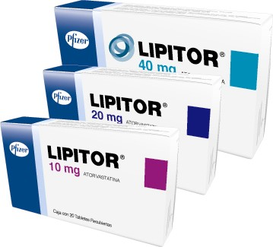
Reference Product
Identified by the Regulatory Authorities as
“Designated Reference Product”
Usually the Global Innovator’s Product
Protected by a patent
Marketed under manufacturers brand name
Clinical efficacy & safety profile is well documented in
extensive trials
All generics must be Bioequivalent to it
In India, CDSCO may approve another product as Reference product

Slide 54
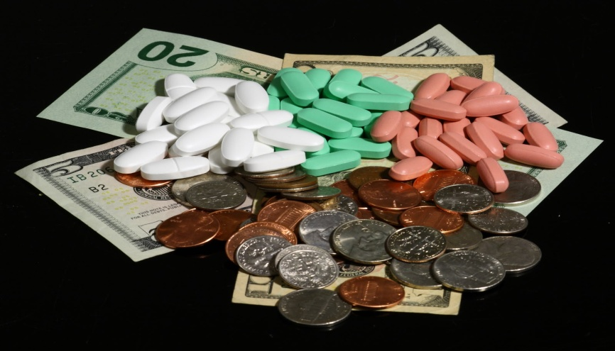
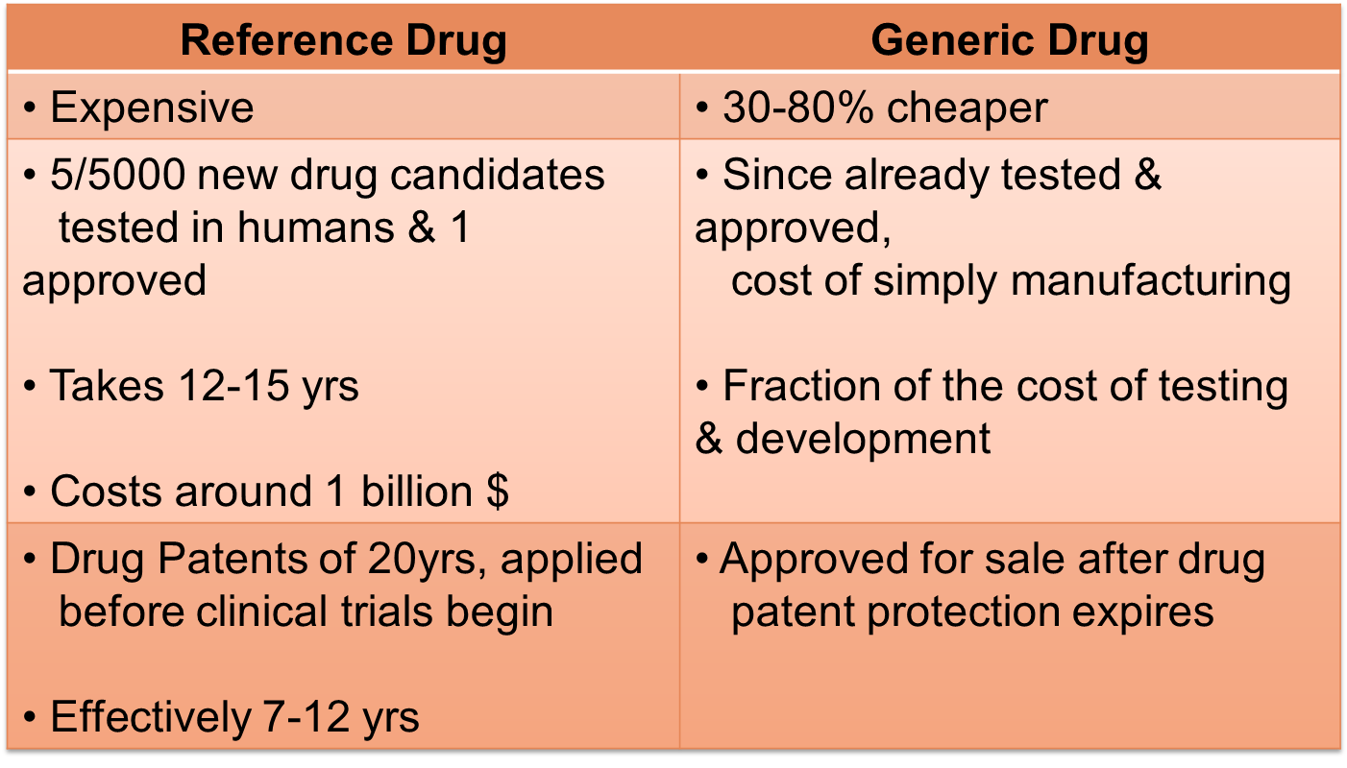
Price difference between Reference & Generic Drugs

Slide 55

Fundamental Bioequivalence Assumption
When a generic drug is claimed bioequivalent to a
Reference drug, it is assumed that they are
therapeutically equivalent
Notes:
The United States Food and Drug Administration (FDA) bans the import of more than 30 generic drugs made by Indian drug firm Ranbaxy. FDA found “manufacturing quality problems” at two of Ranbaxy's factories in India.

Slide 56
Bioequivalence Background
Using bioequivalence as the basis for approving generic copies in US“Drug Price Competition and Patent Term Restoration Act of 1984,” also known as the Waxman-Hatch Act
Created Generic Industry & ↑ their availability
Most successful legislation
Benefited Brand & Generic firms
Generic firms→ Rely on findings of safety & efficacy of Innovator drug after Patent expiration
Innovator firms→ Patent extensions of 5yrs to make up for time lost while their products were going through FDA's approval process

Slide 57

Indian Legislation
In India, CDSCO provides “Guidelines for Bioavailability &
Bioequivalence Studies” mentioned in Schedule Y
As per the Drugs & Cosmetic Rules (IInd Amendment) 2005,
all bioavailability and bioequivalence studies should be conducted
in accordance to these Guidelines
News:
Ranbaxy faces possibility of a permanent injunction in US
CNBC; January 27, 2012
Notes:
2 Manufacturing plants not as per US-FDA standards for 50 drugs

Slide 58
Requirement of BA & BE Studies
For IND/NDAs:
To establish equivalence between:
Early & late clinical trial formulations
Formulations used in clinical trial & stability studies
Clinical trial formulations & to-be-marketed drug product
Any other comparisons, if appropriate
ANDA for a generic drug product
Change in components, composition, &/or manufacturing process
Change in dosage form (capsules to tablet)
Notes:
New method/formulation is test, earlier is reference

Slide 59
Objectives of BA & BE Studies
Development of suitable dosage form for a New Drug Entity
Determination of influence of excipients, patient related factors &
possible interactions with other drugs
Development of new drug formulations of existing drugs
Control of quality of drug products, influence of →
processing factors, storage & stability
Comparison of availability of a drug substance from different form
or same dosage form produced by different manufacturers

Slide 60
When is Bioequivalence not necessary (Biowaivers)
Parental Solution; same active substance with same concentration, same excipient
Oral Solution; same active substance with same concentration, excipient not affecting GI transit or absorption
Gas
Powder for reconstitution as solution; meets criterion (a) or (b)
Otic/Ophthalmic/Topical Solution; same active substance with same concentration, same excipient
Inhalational Product/ Nasal Spray; administered with or w/o same device as reference product ; prepared as aqueous solution ; same active substance with same concentration, same excipient

Slide 61
NDA vs ANDA Review Process
NDA Requirements ANDA Requirements
  1. Chemistry 1. Chemistry
  2. Manufacturing 2. Manufacturing
  3. Controls 3. Controls
  4. Labeling 4. Labeling
  5. Testing 5. Testing
  6. Animal Studies
  7. Clinical Studies 6. Bioequivalence
  8. Bioavailability

Slide 62

Orange Book
All FDA approved drugs listed
(NDA’s, ANDA’s & OTC’s)
Expiration of patent dates
Drug, Price and Competition Act (1984)
FDA required to publish Approved Drug Products with
Therapeutic Equivalence & Evaluations

Slide 63


